Slide 1

Rapid, Healthy, Permanent Weight Loss
Notes:
Introduction
Say: If you want to lose weight, we have a program that combines exercise and nutrition to get amazing results that are healthy, fast, and permanent. Show them a few success stories as you tell them what each person lost in the first 30 days.
More Info:
If you want to lose weight, we have a program that combines exercise and nutrition to get amazing results that are healthy, fast, and permanent. Our average person on our program will lose 20 pounds in 30-days and go on to average 10 to 15 pounds of loss each month thereafter. As soon as you have actual success stories, don’t give them an average, look at the stories with them and tell them what each person lost in the first 30 days.
Tell them about someone you signed up 30 days ago and how they are doing e.g. “Mary joined with my 45 days ago and her primary goal was weight loss. She is here just three days a week for an hour and using the weight loss program I’m about to show you. She lost 29 pounds and loves the program. Here is her graph (show her your supporter graph)
Let me show you how our program works

Slide 2
Existing Weight Loss Programs
99% of Existing Programs:
Based on two or three principles
Rely on portion control and counting calories
Simply don’t work
These Programs are:
Missing key features
Difficult to stick to
Unhealthy
Temporary
Notes:
Existing Weight Loss Programs
Say: Most programs don’t work because they’re based on just one or two principles and don’t include important features that make losing weight much easier.
More: Most weight loss programs don’t work for most people. Most of our members have tried every diet on the planet and they all tell me the same story. They lose some weight; hate being on a diet so they don’t lose all the weight they would have liked, and go back to their normal eating habits when the diet is over. They end up gaining all the weight they lost back.
Most weight loss programs use two or three principles of weight loss and if they encourage exercise, they don’t explain how to do it without increasing hunger.
Most programs are missing critical principles and feature so they don’t work for everyone. They are unhealthy, difficult to stick with and any weight lost, is gained back after a few weeks

Slide 3
The 70/30 Weight Loss Rule
Notes:
The 70/30 Weight Loss Rule (this is an important slide and worth getting right)
Say: Weight loss is 70% nutrition and 30% is exercise. If you don’t have both components, it’s much harder to lose weight. With our program you get exercise and nutrition.
More: 70% of weight loss is nutrition and 30% is exercise. If you don’t have the nutrition component, your chances of losing weight are decreased by 70%. You can run for hours, take every fitness class we have, or lift weight all day but if you don’t know the 22 principles of weight loss and how to apply them, it will be 70% harder to lose weight. If on the other hand you combine moderate exercise with a nutritional program, the weight will melt away and after it’s gone, it’s easy to keep the weight off, improve your health, and look fit and trim with just 45 minutes of exercise three days a week.

Slide 4
Nutrition-Based Weight Loss
Nutrients
Metabolism
Burning More Calories
Reduced Hunger and Cravings
Better Food Choices
Food Based Supplements
Notes:
This is Nutrition-Based Weight Loss (this is an important slide and worth getting right)
Say: Our program is nutrient-based. When your cells don’t get all the nutrients they need, the activity in your cells slows down so you burn fewer calories and to make you eat more to get those nutrients, you experience hunger and cravings. Hunger and cravings occur when your cells aren’t getting the nutrients they need to function. If you eat the right food and take the right supplements, you will burn more calories, experience less hunger, and fewer cravings. Getting nutrients to your cells is the key to rapid weight loss you don’t gain right back.
More: Our program is nutrient-based. Let me explain what that means. When our cells don’t get all the nutrients they need, cell activity (metabolism) slows down and we burn fewer calories. Our cells need nutrients to function. If we don’t supply our cells with the nutrients they need, we experience hunger and cravings. Hunger and cravings make us eat to get more nutrients for our cells. A lack of nutrients is the underlying cause of hunger and cravings, overeating, obesity, and weight gain. People eat food that does not supply the nutrients they need so they are always eating. This is why so 70% of the population is overweight. It’s also why people who simply cut calories to lose weight will gain the weight right back.
We will teach you how to choose and prepare food that has the most nutrients and to use food-based supplements to make up the difference between the nutrients they get from food and what their cells need to burn more calories without triggering hunger and cravings. When you get the nutrition your cells need, hunger and craving will no longer make you overeat.

Slide 5
You Need Three Phases
Weight Loss
Stabilization
Maintenance
Notes:
We Provide Three Phases of Weight Control
Say: Most programs are focused on weight loss but do very little to prevent you from gaining the weight back. To lose weight and keep it off, you also need to stabilize your weight once you reach your goal. This resets your weight so it’s much harder to gain the weight you lose right back. Then you need a Maintenance Phase where you learn the skill of keeping your weight from slowly creeping back to where you started.
More: Our stabilization step teaches you how to keep your weight to within two pounds of your target weight and our maintenance phase teaches you how to eat anything thing you want and as much as you want and keep your weight to within five pounds of your target. This makes the results you achieve on our program more stable and permanent than any other program.

Slide 6
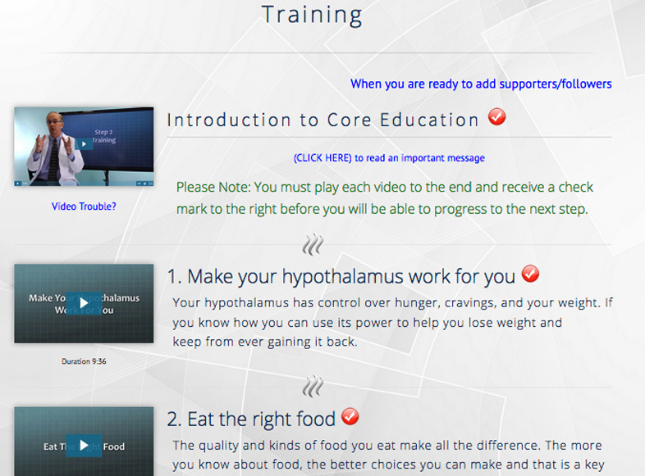
22 Principles of Weight Loss
Notes:
22 Principles of Weight Loss & Control
Say: Our program will teach you everything there is to know about losing weight and keeping it off. You become the expert so you always know what to do and never need to guess.
More: There are 22 principles of weight loss, not just two or three as most weight loss programs would have you think. When you understand these 22 principles you will know everything there is to know about how to lose weight and keep from gaining it back. Dr. Schmitt, will teach you all twenty-two principles, or factors, that determine if your weight will go up, go down, or stay the same. This allows you to understand why you gained weight in the first place, how to lose as much weight as you want, and how to keep from gaining it back. Knowing all the principles also gives you the flexibility to customize the program to meet your own particular needs. You don’t need to follow all 22 principles to lose weight so you can pick the principles you want to follow based on your particular situation.
Once you know what the principles are, you need to learn to apply them. That’s where our daily feedback feature comes in.

Slide 7
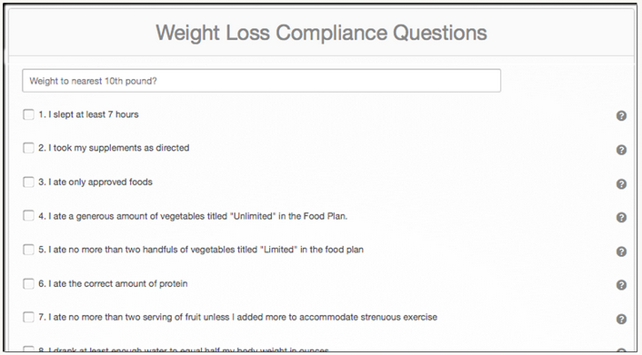
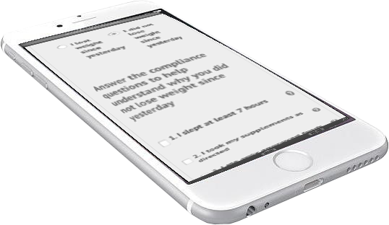
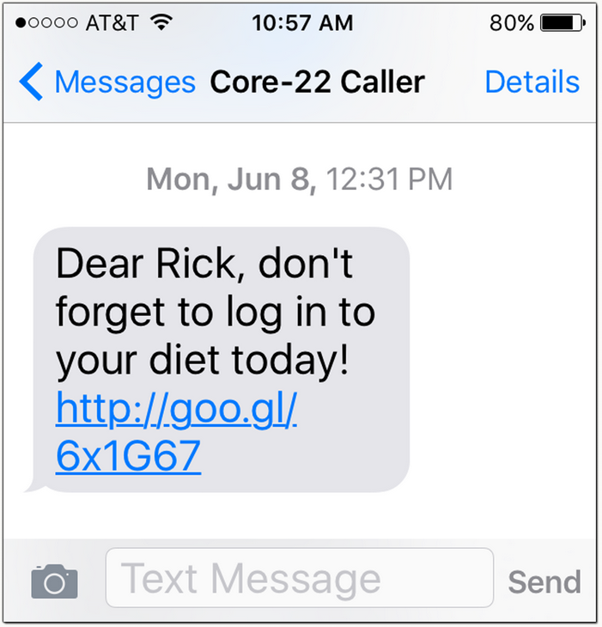
Learning to Apply the Principles with Daily Feedback
Reminder Text
Notes:
Daily Feedback
Say: To learn how to apply the principles, the program provides you with daily feedback. This way you know what you are doing right or wrong each day. In just a few weeks you’ll be able to apply the principles automatically, without having to think about it. At that point you will have a new skill that allows you to control your weight.
More: To apply the principles consistently, you need to know what you are doing right or wrong each day and how what you did, influenced your weight. This allows you to make minor adjustments and see how applying each principle influences the amount of weight you lose. This also allows you to master each new principle. Each day the system will send you a text message that includes a link that will take you to your weight loss graph and a list of questions related to the principles. You enter your weight, answer twenty-two yes or no questions based on the principles, and that allows you to quickly learn the relationship between your actions, decisions, and results. This process makes it possible for you to learn the consequences of your actions so you can begin to make better decisions about what, when, and how much to eat.
People say this feedback system works so well that it only takes a few weeks before they can predict their weight based on what they did the day before, and that it makes them think twice before doing something they know is going to slow down or stop their progress.

Slide 8
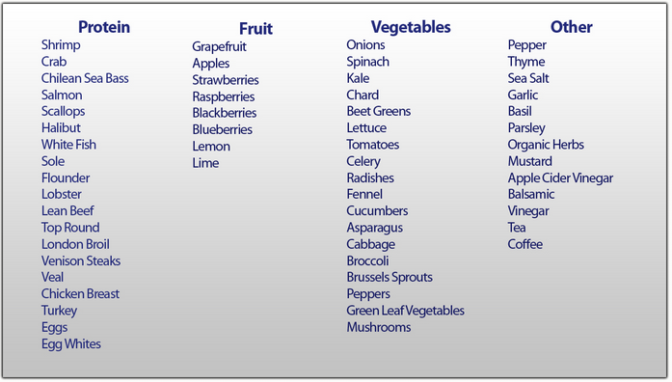
Great Tasting, Nutrient Rich Food Plan
Notes:
Weight Loss Food Plan
Say: The program teaches you how to make the best food choices from a list of the most nutrient rich meats, fruits and vegetables. These are the choices that have the fewest calories and the most nutrients so you burn the most calories while experiencing the least amount of hunger.
More: Since our program is nutrient-based, you will learn which food choices provide your cells with the most nutrients and the fewest calories. These are the food choices that you make while losing and stabilizing your weight and when on maintenance to get back to your target if you start to gain weight again. The food, as you can see, is not restricted to just a few choices. You can eat steak, seafood, eggs and most of the food choices you make already. You will just eliminate things that have little to no nutrition or have more calories than other choices that supply a greater number of nutrients. People on the program love the food so much that they continue to eat from this list long after they reach their ideal weight, avoiding junk food except on rare occasions.

Slide 9
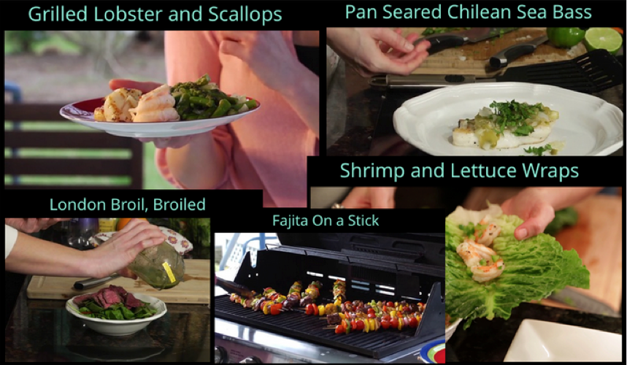
Learn to Cook Great Tasting Food
Notes:
Learn to Cook Great Tasting Food
Say: The program teaches you how to make meals that taste great so you don’t mind staying on the program and eating this way even after reaching your goal.
More: Our cooking videos are simple enough for anyone to follow. We recorded one of the people on the program who loved to find ways of making the choices she made great tasting and fun. If you don’t know how to cook, these videos will teach you enough that you will be able to cook anything you want and make it taste great.

Slide 10
Food-Based Supplements Metabolism, Hunger, Cravings, Calories
What is a supplement?
Why food-based?
The food supply
22 servings of fruits & vegetables / day
1 pound of salmon / day
Notes:
Food Based Supplements (This is important. It’s worth learning and practicing because it explains why supplements are so important)
Say: The program includes food-based supplements. Most people take supplements without really understanding what supplements are supposed to do. Supplements are supposed to make up for the nutrients you don’t get from your diet. The problem with most supplements is they are man made. There are thousands of nutrients in food so you would have to take thousands of different supplements to get all the nutrients you need unless they are made from real food. When you take the right combination of food-based supplements and eat the right food, you reduce hunger and cravings and burn more calories.
More: You will take food-based supplements to make up the difference between what you can get from a nutrient rich diet and what your cells actually need to reduce hunger and maximize the calorie burning capacity of your cells.
Unlike the majority of supplements sold today that are synthesized in a factory from oil, these supplements come from fruits, vegetables and wild caught fish. They make it possible for your cells to get all the nutrients needed to burn the most calories with lowest amount of hunger and cravings. This is why the diet is so healthy and easy to follow. It’s also the primary reason why people on the program lose weight so fast and find it easy to keep the weight off.
If you attempted to eat enough food to get the nutrition your cells need you would have to eat fifteen servings of fruits and vegetables and a pound of wild caught salmon each day. It would not only be very expensive, it would absolutely cause you to gain weight.

Slide 11
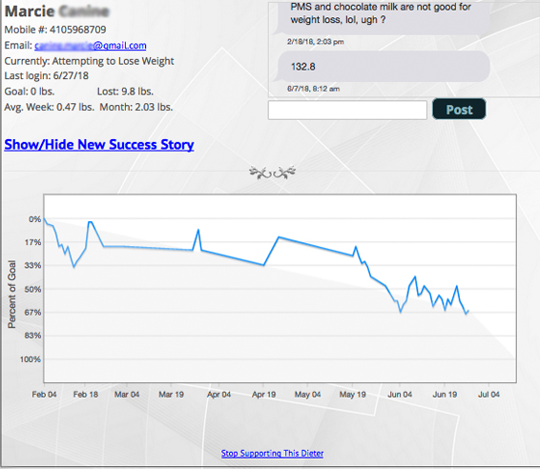
Friends and Family Support
Notes:
Supporters Provide Motivation
Say: You are three times more likely to reach a goal if you have someone you know personally following your progress. Our program has a system that allows you to choose a few friends of family members to do just that. And when they see you lose weight, it may inspire some of them to do the same thing so we give them the same discount code you will get when you become a member as our way of saying thanks for their help.
More: The program has a social support component that will help motivate you to stick to the program. We ask you to enlist a few friends and family members to simply follow your progress. We will send them text messages that includes a link to a page where they will be able to see a graph of your progress and leave a comment. They never see your actual weight, just how much you have lost. Every time a one of them visits your page, we let you know. When you know that your friends and family will see how your doing, you will do your best. If you really want to lose weight, this feature makes it much easier because you never get the idea to skip a day or to throw caution to the wind. When that voice in your head tells you “Go ahead, eat whatever you want”, knowing you have people you know following your progress, really keeps you moving straight ahead.

Slide 12
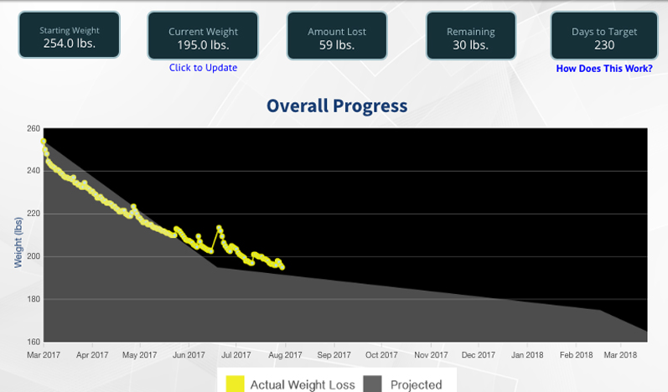
Weight Loss Graph
With Target Date
Notes:
Weight Loss Phase
Say: This is a typical weight loss graph. It shows where you are and how long it will take to reach your goal based on your actual rate of weight loss.
More: In weight loss you will apply the principles you were taught in training. You will see comments from your followers and if you don’t lose weight on any particular day, you will learn why with our daily feedback questions. This graph allows you to know where you are in the process and how long it will take to reach your target based on you actual rate of weight loss.

Slide 13
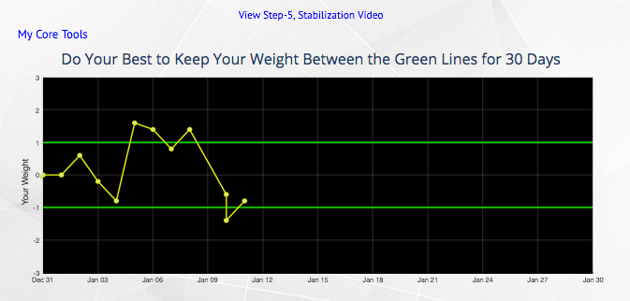
Stabilization
Notes:
Stabilization Phase
Say: When you reach your goal, you will learn to keep your weight constant for 30-days. This does something in your brain to set your weight at this new level. Have you ever noticed that when you are not on a weight loss program, you don’t have to do anything and your weight stays around the same, going up and down a few pounds but basically the same? When you stabilize your new weight, the same things happens at this new weight.

Slide 14
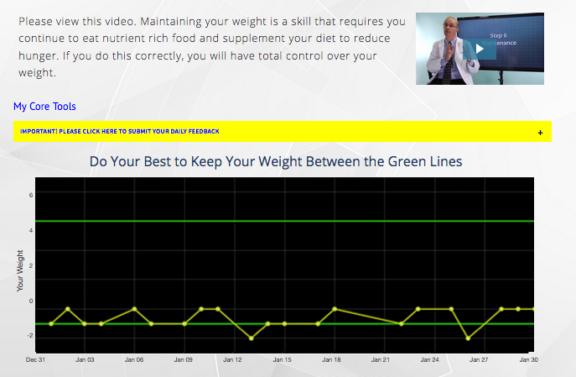
Maintenance
Notes:
Maintenance Phase
Say: More: When your reach your goal and stabilizes your weight, there are things you should do to maintain it. Even though your weight is stable, you can still gain weight if you constantly eat too much, or don’t get the nutrients your cells need to prevent chronic hunger.
We will teach you how to monitor your weight so you know exactly what to do to keep your weight within a five-pound range. As long as you do that, you will never gain the weight back

Slide 15

Learn everything there is to know about weight loss
Learn the right way to combine diet and exercise
Learn what food to eat or avoid, and why
Eat healthy food and supplement the right way
Experience less hunger, fewer cravings
Burn more calories
Lose all the weight you want and keep it off forever
Notes:
Say: When you combine our nutritional program with exercise, you will drop weight faster than you ever though possible and unlike other programs, you will learn how to keep the weight from ever coming back.
Note: You can also read each bullet and when done, ask if they have any questions.
If you didn’t show them success stories earlier in the presentation, do that here. e.g. “Let me tell you about someone who signed up for this program just 45 days ago…”

